Slide 1
Lecture 7
Cumulative Distributions

Slide 2
Review
1 Why do we square the deviations before averaging them?
Because the deviations always sum to zero – the positives cancel the negatives, so their average is 0 for every dataset.
2 The variance came out in squared units. What fixes that?
Taking the square root. The standard deviation is back on the scale of the data.
3 Why divide the sum of squares by n - 1 rather than n?
The deviations must sum to zero, so once you know n - 1 of them the last is forced. Only n - 1 are free to vary.
4 Where do the two fences sit, and what do they decide?
At Q1 - 1.5(IQR) and Q3 + 1.5(IQR). Anything outside them is an outlier, and the whiskers stop before them.

Slide 3
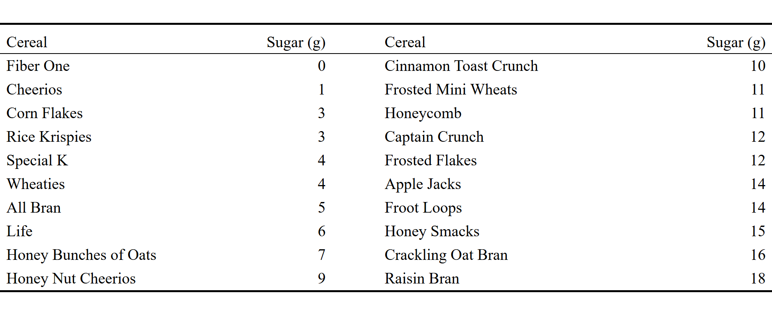
The data: sugar in twenty breakfast cereals
X = grams of sugar per serving, for twenty cereals on a US supermarket shelf
n = 20, so n is even - keep that in mind, it changes how we read one thing later

Slide 4
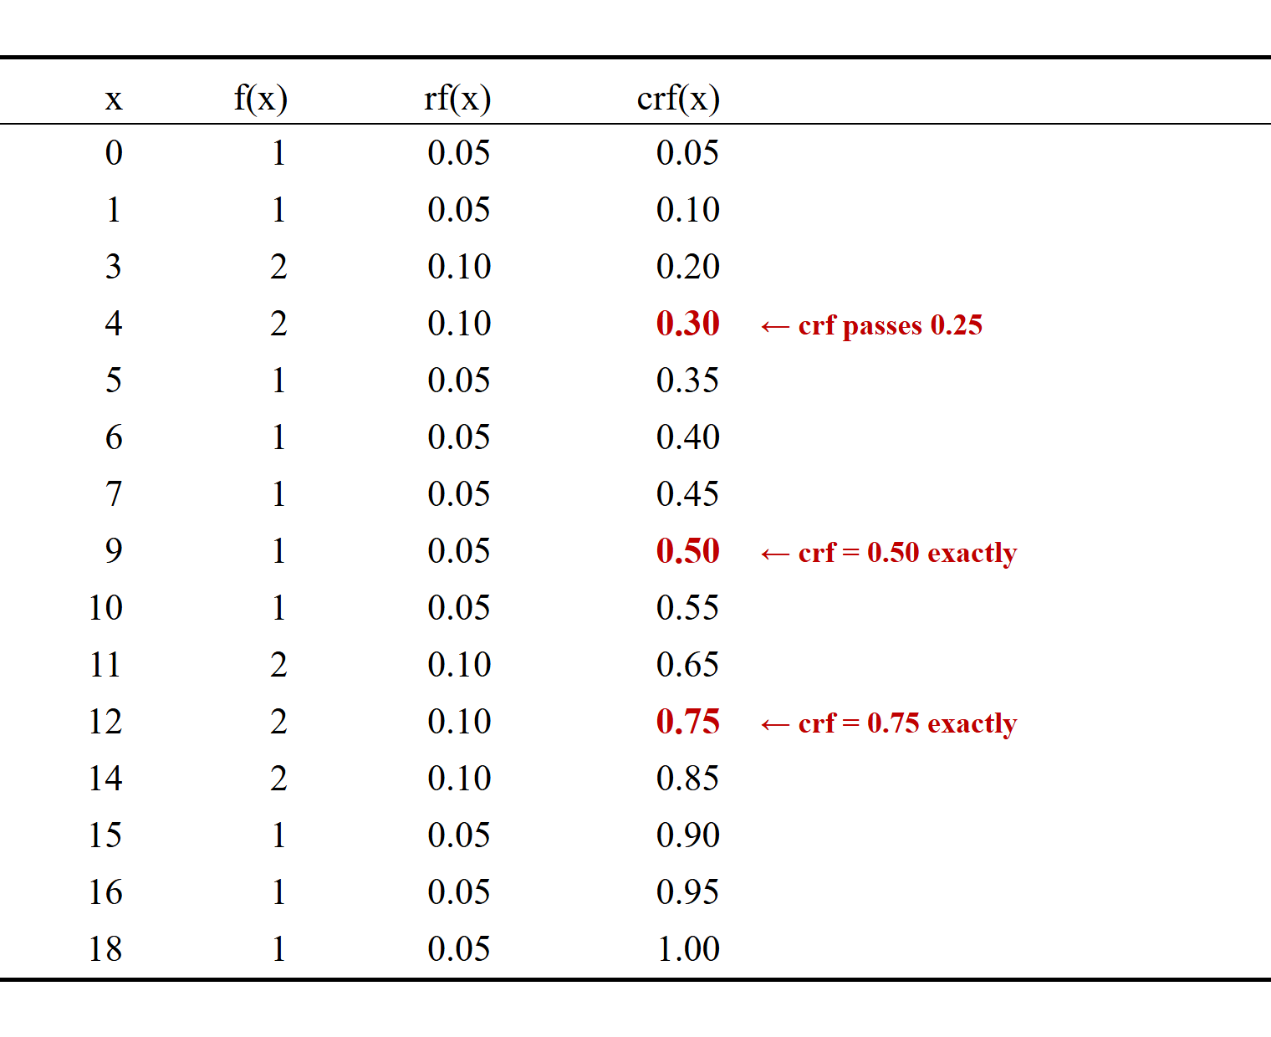
Cumulative distributions
A cumulative distribution shows the relationship between the value of a variable and the cumulative relative frequency
crf(x) answers one question: what fraction of the data falls at or below x?
  It only ever climbs - it can never come back down
  It starts at 0 and finishes at 1
For discrete data we draw it as a step function: flat between observed values, jumping at each one
  The height of a jump is that value’s relative frequency

Slide 5
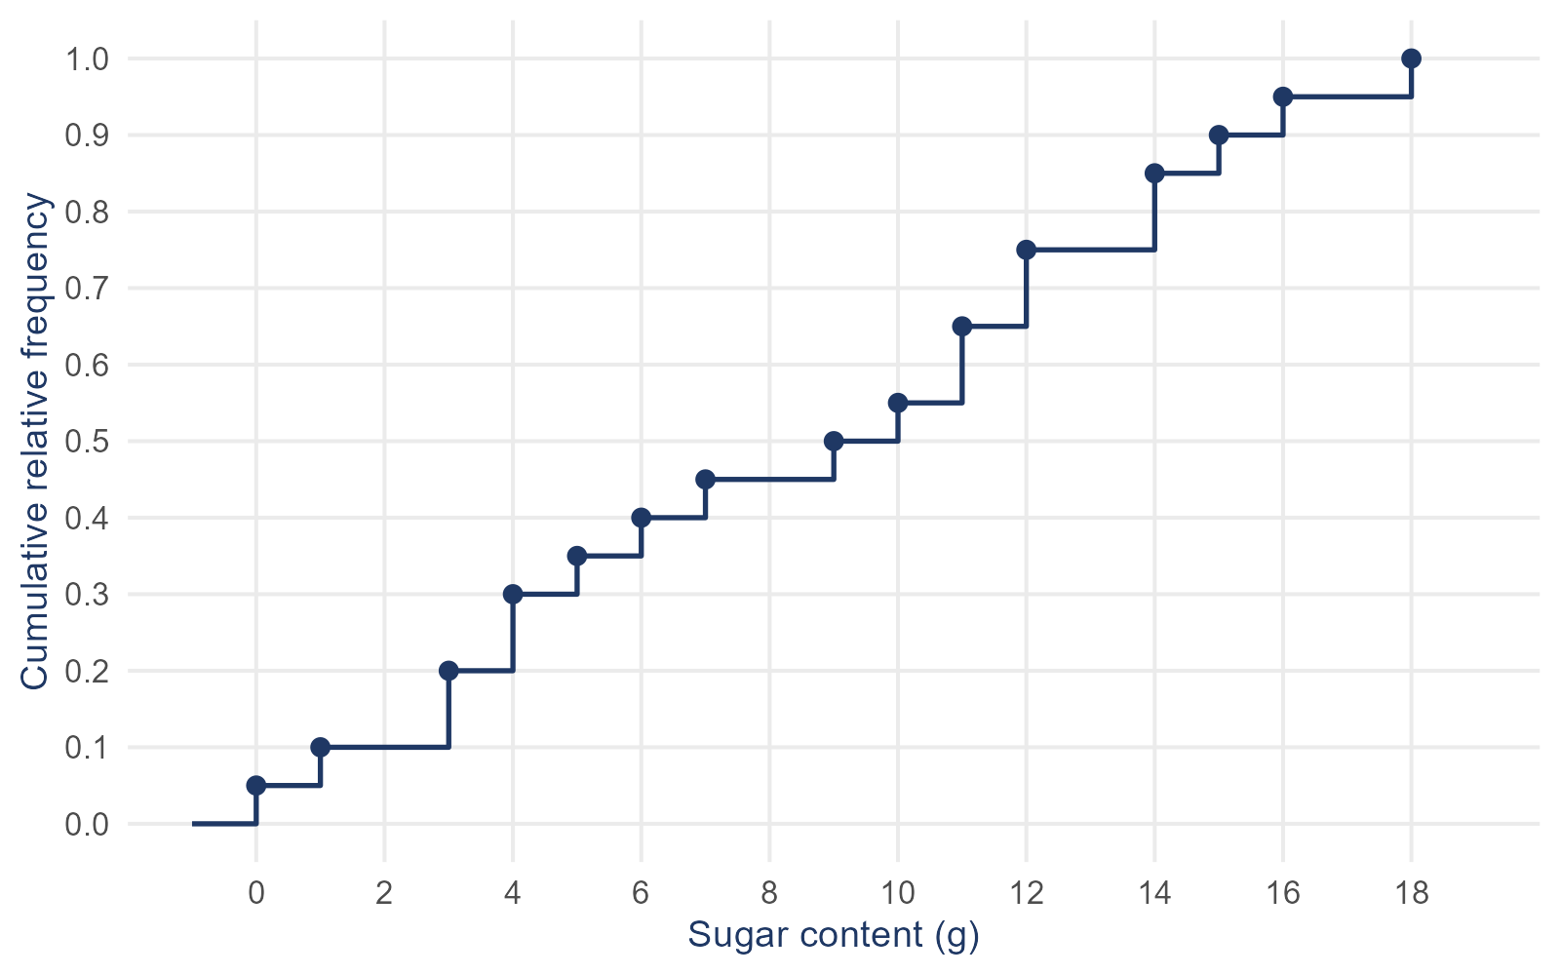
From the table to the plot
Put the values of the variable on the x-axis and crf(x) on the y-axis
Plot a point at each observed value
Hold that height flat until the next observed value, then jump
The flat runs are not decoration - they are what we read a percentile off

Slide 6
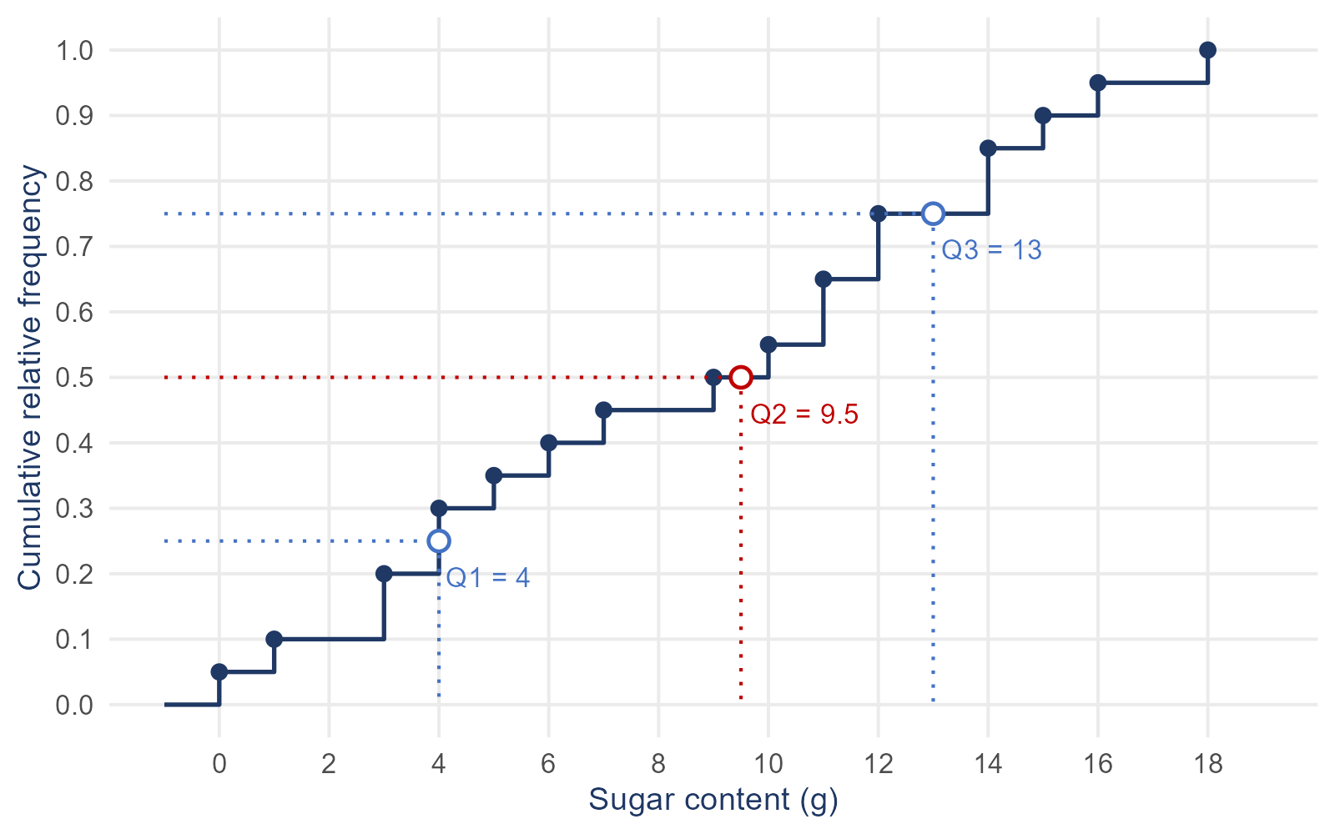
Reading a percentile off the plot
To find the pth percentile:
  go up the y-axis to p/100
  read across to the curve
  drop down to the x-axis
Q1, Q2 and Q3 are just the percentiles at 0.25, 0.50 and 0.75
  Q1 = 4 Q2 = 9.5 Q3 = 13
  IQR = 13 - 4 = 9

Slide 7
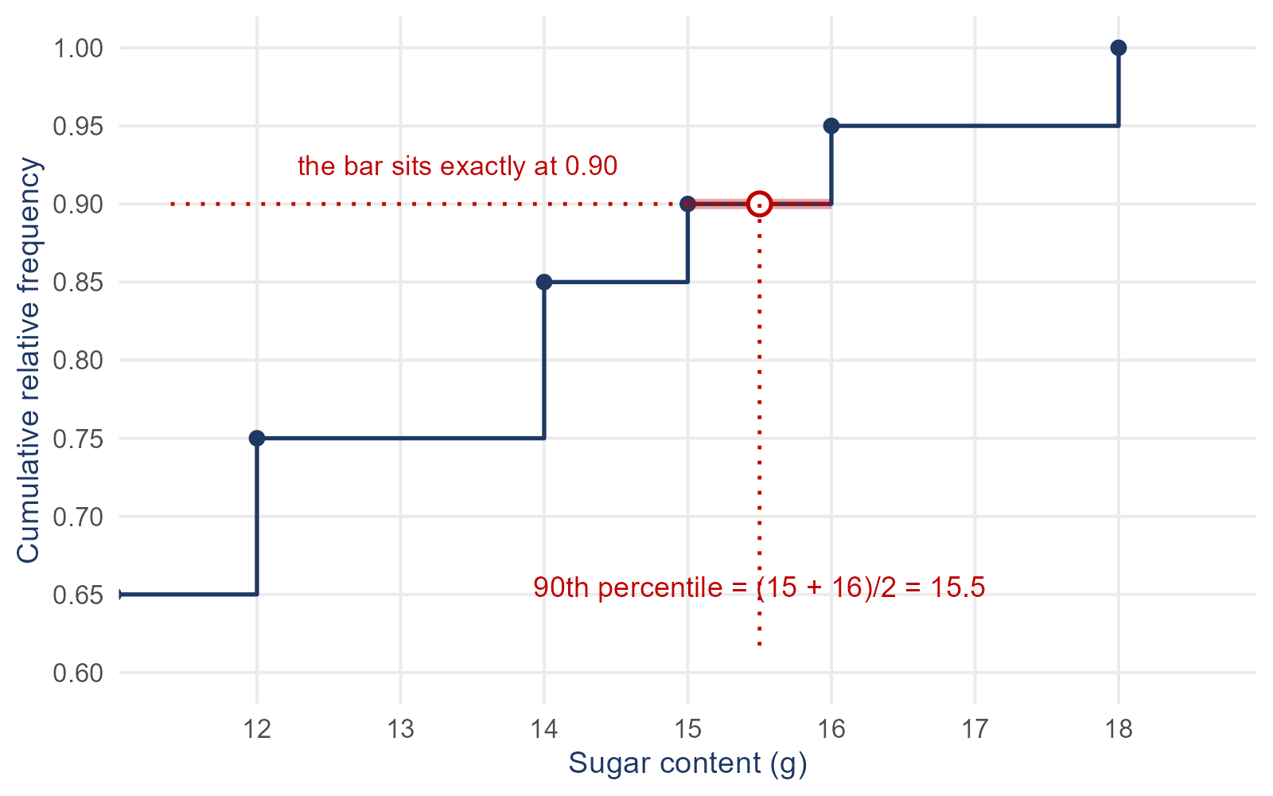
When the bar sits exactly on the percentile
Reading across at p usually crosses a jump, and the answer is that value
But sometimes the line lands ON a flat run instead
  then the pth percentile is the midpoint of that bar
This happens when n is even, which is why n = 20 mattered
  crf reaches 0.90 exactly at x = 15, and the next value is 16
  so the 90th percentile is (15 + 16)/2 = 15.5, not 15
Same story at 0.50 and 0.75, which is why Q2 = 9.5 and Q3 = 13

Slide 8
Going the other way: what percentile is this value at?
The same plot answers the reverse question. Start on the x-axis instead:
  go along to the value
  up to the curve
  across to the y-axis, and read crf
Your turn: Honeycomb has 11 g of sugar. What percentile is it at?
And what about All Bran, at 5 g?
Working:
11 g -> crf = 0.65 -> 65th percentile
5 g -> crf = 0.35 -> 35th percentile
65% of these cereals have at most as much sugar as Honeycomb.

Slide 9
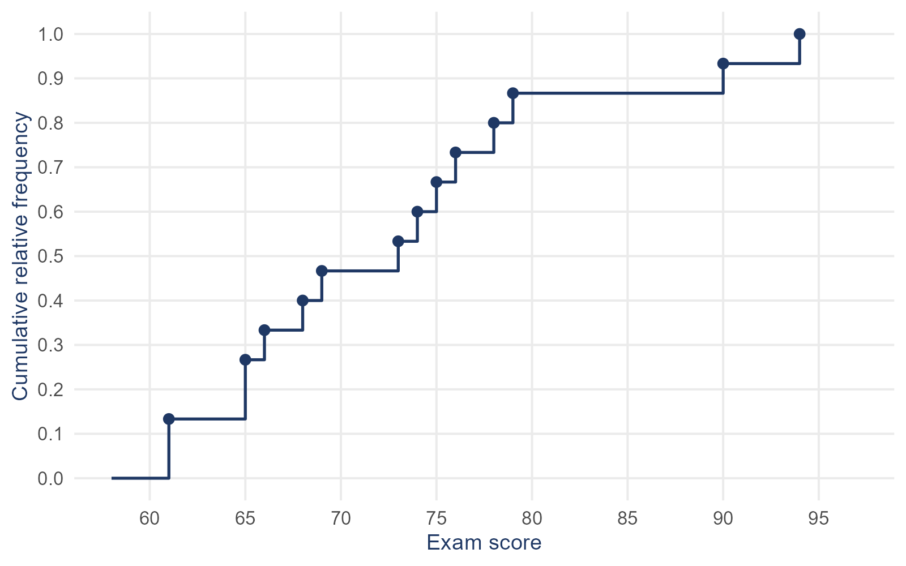
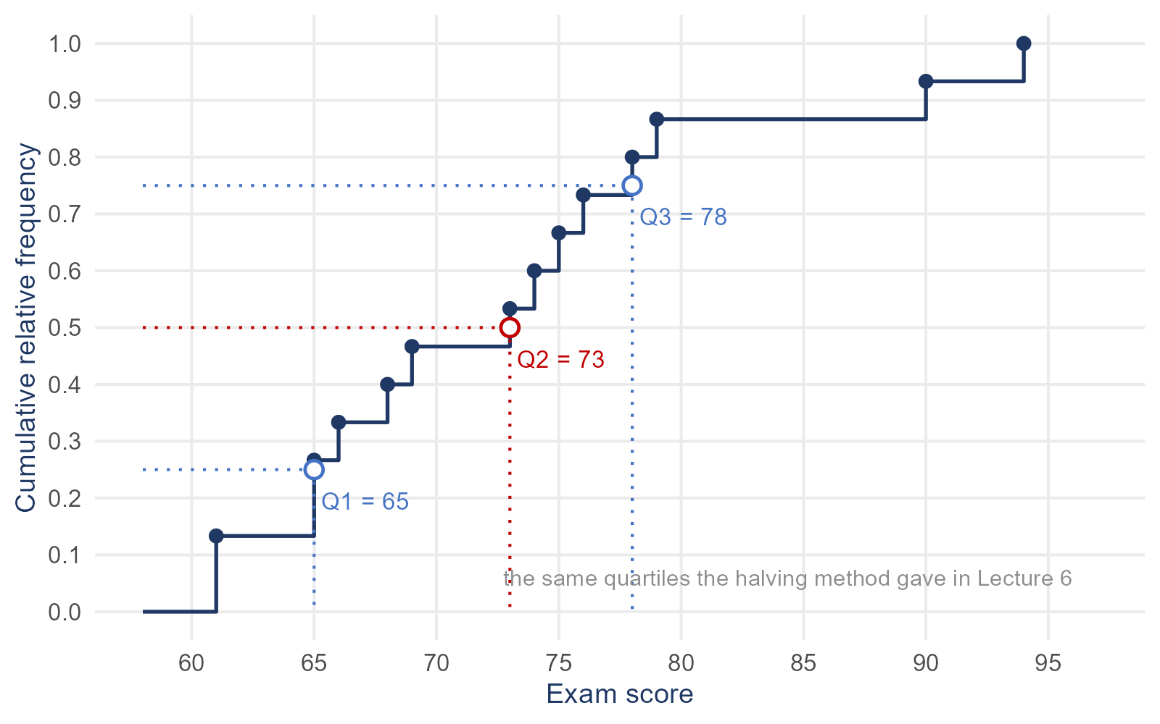
Practice: quartiles from a cumulative distribution
This is the cumulative distribution of the 15 exam scores from Wednesday
Read Q1, Q2 and Q3 off the plot
n = 15 is odd this time. Does the midpoint rule come into it?
Then check your answers against the ones you got by halving the ordered data

Slide 10
Two pictures of the same five numbers
The step plot and the boxplot are not competing summaries - the boxplot is five readings off the step plot
  the minimum is where the curve leaves 0, the maximum is where it reaches 1
  Q1, Q2 and Q3 are the readings at 0.25, 0.50 and 0.75
What each one is good for:
  the step plot gives you ANY percentile, not just the quartiles
  the boxplot is far easier to compare across groups, and it flags outliers
  the histogram is still the only one of the three that shows peaks and gaps

Slide 11
Descriptive statistics: the whole toolkit
Every question we have asked about a single variable falls into four buckets
  SHAPE - symmetric, skewed, how many peaks, gaps and outliers (histogram, dot plot, stem and leaf, boxplot)
  CENTER - mean, median, mode
  SPREAD - range, IQR, variance, standard deviation
  POSITION - percentiles and quartiles (ordered data, or the cumulative distribution)
Resistant to outliers: the median, the mode, the IQR
Not resistant: the mean, the range, the variance and the standard deviation
Shape decides which pair you report - mean with s, or median with IQR

Slide 12
End of the material for Exam 1
Everything on Exam 1 has now been covered. Monday starts new material that is NOT on it.
Wednesday September 16 - in-class review
Friday September 18 - Exam 1, in class
  delivered through Canvas, so bring a charged laptop
  a calculator is allowed, as long as it cannot communicate wirelessly
  notes are not permitted; the formula sheet is printed on the study guide
The study guide and the review problems are on the course website, under Exam Study Guides
Homework 1 is due Sunday at 11:59 PM

